Slide 1
Metals, Non-Metals and Metalloids

Slide 2

By the end of this Smart Lesson, you should be able to:
1. | Describe the characteristics of metals, non-metals and metalloids.
2. | Distinguish between metals, non-metals and metalloids based on their characteristics.

Slide 3
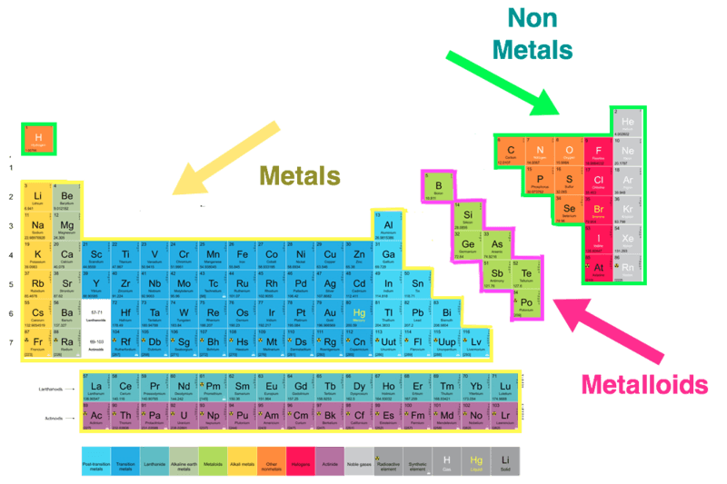
Most elements are metals.
They are found on the left hand side of the periodic table.

Slide 4
On the right of the table are the non-metals.
There aren't as many as metals, but they're just as important!

Slide 5
Elements on the border between metals and non-metals behave a bit like metals and a bit like non-metals.
They are called metalloids.

Slide 6
Although it appears on the left side of the periodic table, hydrogen is a non-metal.
This is an exception to the rule, because hydrogen does not show any metallic properties.

Slide 7
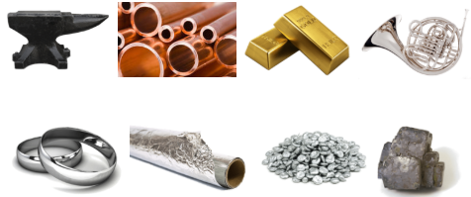
Metals are a group of elements that have certain characteristics in common.
Can you think of any characteristics that metals share?

Slide 8
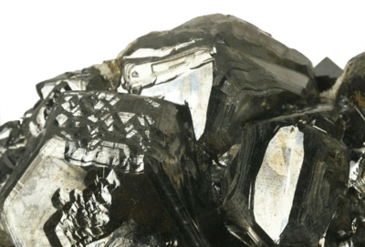
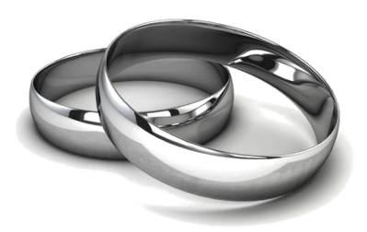
Metals are very shiny, which is known as being lustrous.
Some metals are more lustrous than others, and some need to be polished first.

Slide 9
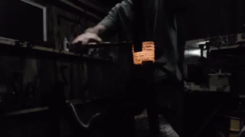
Metals can be drawn out or stretched into a wire, which is known as being ductile.
One gram of gold can be drawn into a wire 2,300 meters long!

Slide 10
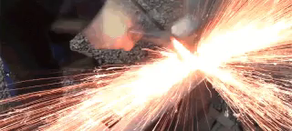
Metals can be beaten or bent into a variety of shapes, which is known as being malleable.
Silver, iron and platinum are very malleable. However, gold takes the crown when it comes to malleability.

Slide 11
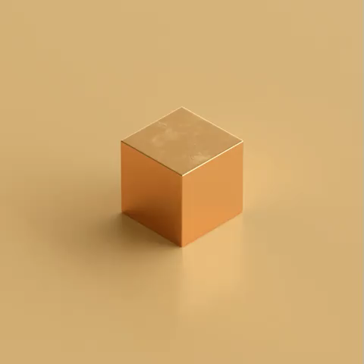
Metals are typically solid at room temperature, with the exception of mercury, which is a liquid.

Slide 12
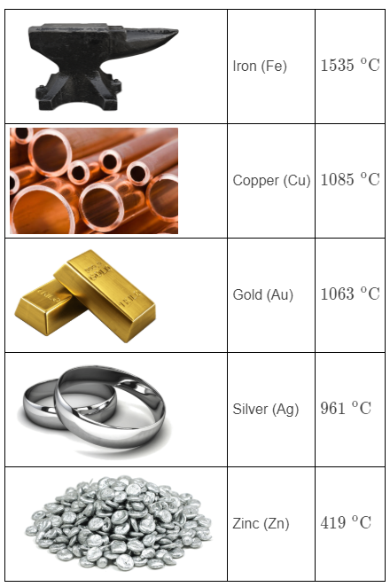
Metals usually melt at a high temperatures.
Mercury is an exception as it melts at −40∘C.

Slide 13
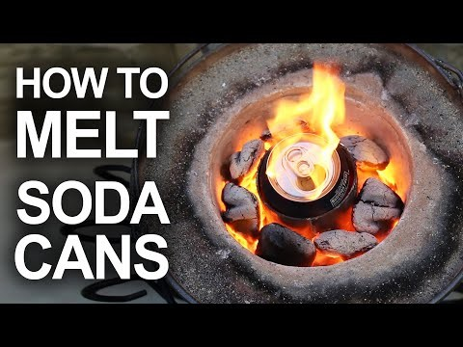

Slide 14

Metals are good conductors of heat and electricity.
This why electrical circuits are made using metals, and why our pots and pans are all metal!

Slide 15
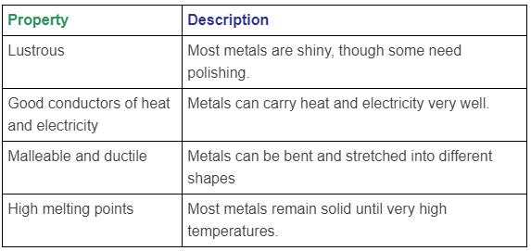
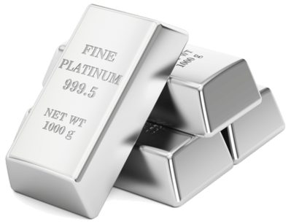
The properties of metals have been summarised in the table below:

Slide 16
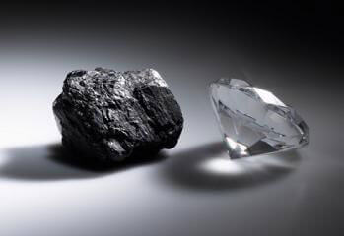
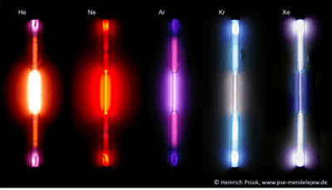
Only 22 elements on the periodic table are non-metals, yet it is these elements that make up most of the world around us.
This is because, although there are considerably fewer non-metals than metals, they have considerably more variation.

Slide 17
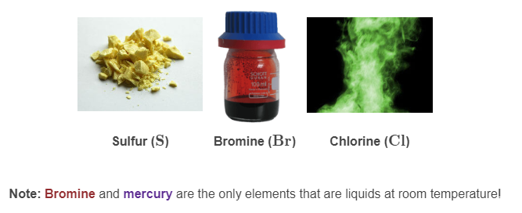
At room temperature, 11 non-metals are gases, 10 are solid and 1 is a liquid.

Slide 18
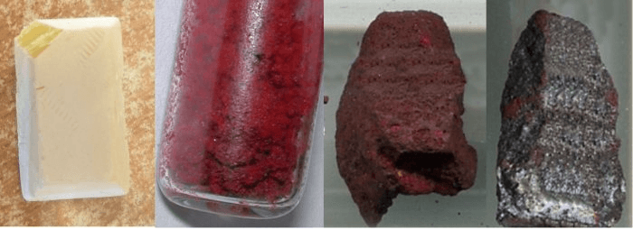
Non-metals tend to be dull, which means they are not lustrous or shiny.
Every form of phosphorus is dull.

Slide 19

Non-metals are unable to be bent into shapes or flattened; instead, they shatter when hit.
This is known as being brittle. Non-metals have a very rigid structure. Bending them breaks this structure, and causes them to crumble rather than bend.

Slide 20

Non-metals are poor conductors of heat and electricity.
This is why you won't find an electrical circuit made out of a non-metal. In fact, wires are usually protected (or insulated) by covering them in a non-metal!

Slide 21
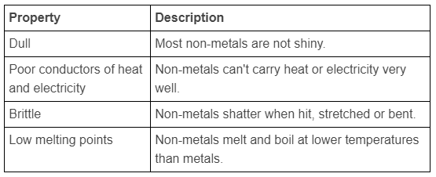
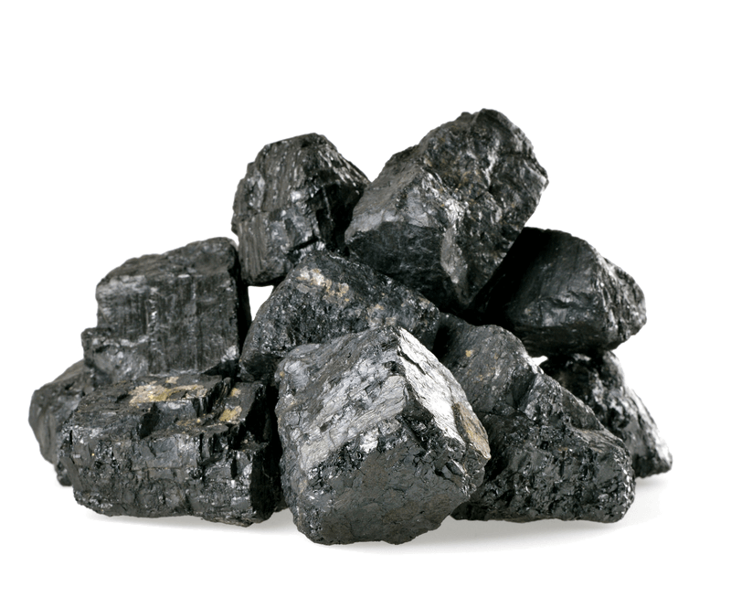
To summarise, non-metals have the following properties:

Slide 22
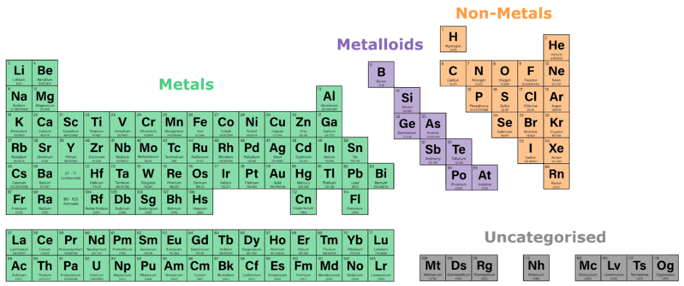
Metalloids are a group of elements that have characteristics of both the metals and non-metals.
There are 8 elements in this group. They are often shown as a zig-zag line of the same colour.

Slide 23
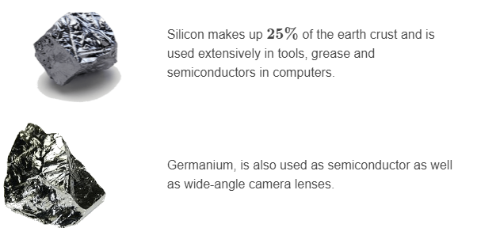
A couple of common examples of metalloids are silicon and germanium.
Silicon (Si) is able to be polished like a metal, but has poor conduction and is not ductile like a non-metal. Germanium (Ge) has a lustre but is also brittle.
The versatility of metalloids makes them very important in terms of modern technology.

Slide 24
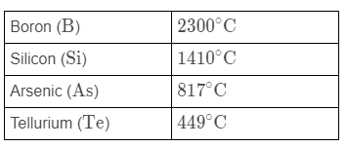
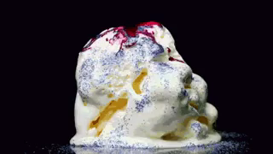
Metalloids melt at range of temperatures.
The table below shows the melting point for some of the metalloids.

Slide 25
